Slide 1

AFLEET Tool to Examine Emissions and costs of alternative fuel vehicles
Andrew Burnham
Principal Environmental Scientist
aburnham@anl.gov
NASEO VW Settlement Emissions Tools Webinar
March 29, 2017

Slide 2


Argonne has Supported DOE’s Clean Cities with Tool Development for 15+ Years
AirCRED
  O₃ precursor & CO emission credits from AFVs for SIPs
Clean Cities AOI 4 Emissions Benefit Tool
  GHG & air pollutant benefits of ARRA grant proposals
GREET Fleet Footprint Calculator
  Petroleum use & GHG footprints of HDVs & off-road equipment
Notes:
For more than 15 years, Argonne has been providing technical analysis and developing tools related to AFVs for the Clean Cities Program. Argonne has also supported local coalition efforts and we are especially active with Chicago Area Clean Cities and other in the area.
The first tool was AirCRED which was released in 1999 and co-sponsored by the EPA and Clean Cities to estimate O₃ precursor & CO emission credits from AFVs for State Implementation Plans
In 2009, we developed a tool to look at emission benefits for Recovery Act Grant Proposals.
Also in 2009, we released GREET Fleet Footprint Calculator, which you might be familiar with. This was developed using Argonne’s GREET Model which is a well known tool for life-cycle analysis of AFVs. That tool was developed to estimate petroleum use & GHG emission footprints of medium/heavy duty vehicles & off-road equipment. This tool supplemented Fuel Economy.GOV, which provides those same results but only for light duty vehicles.

Slide 3



“AFLEET Tool” to Analyze AFV Costs & Benefits
Examines light-duty & heavy-duty vehicle:
  Petroleum use
  GHG emissions
  Air pollutant emissions
  Cost of ownership
Contains 16 fuel/vehicle technologies
  Conventional
  Hybrids
  Plug-in electrics
  Alternative fuels: CNG, LNG, LPG, H₂, ethanol, biodiesel
Includes 7 Major Vehicle Types
  Cost, MPG, & VMT data on 23 vocations
AFLEET Tool 2016 & its user manual available at: http://greet.es.anl.gov/afleet
Notes:
Argonne released AFLEET Tool, which expands off of GREET Fleet’s capabilities to help Clean Cities Stakeholders examine not only petroleum use and GHG emissions but also air pollutant emissions and cost of ownership of light duty and heavy duty vehicles using simple Microsoft Excel inputs.
The model contains 16 fuel/vehicle technologies…
Conventional: gasoline, diesel
Hybrid: gasoline HEV, diesel HEV, diesel hydraulic hybrid
Plug-in electric: PHEV, EREV, EV
Alternative fuel: CNG, LNG, LPG, H₂, LPG B20, B100, E85,

Slide 4

AFLEET Tool’s Calculation Methods
Tool has 3 calculation methods & which to use depends on your goals
Simple Payback Calculator
  Annual emissions & simple payback of purchasing new AFV vs. conventional counterpart
Total Cost of Ownership Calculator
  Lifetime emissions & NPV of costs over the years of planned ownership of a new vehicle
Fleet Energy and Emissions Footprint Calculator
  Annual petroleum use, GHGs & air pollutant emissions of existing & new vehicles
Notes:
Total Cost of Ownership Calculator
Net present value of operating & fixed costs over the years of planned ownership of a new vehicle
Discounted cash flow analysis
Fixed costs = financing, depreciation, insurance, license & registration
Operating costs = fuel, DEF & maintenance
Lifetime petroleum use, GHGs & air pollutant emissions
Fleet Energy and Emissions Footprint Calculator
Annual petroleum use, GHGs & air pollutant emissions of existing & new vehicles
Older vehicles have higher air pollutant emission rates than newer ones

Slide 5
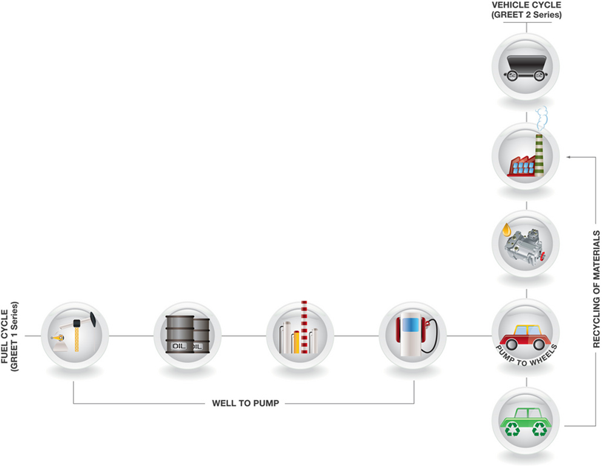
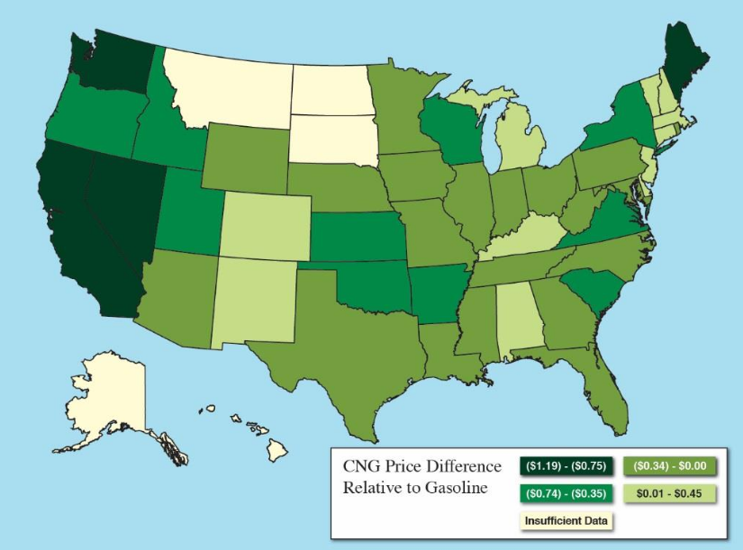
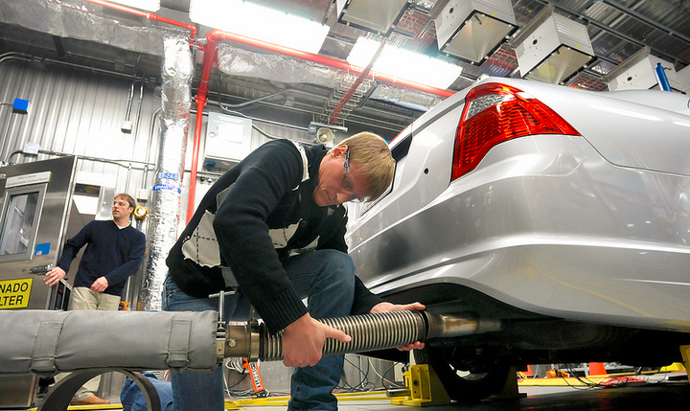
AFLEET Tool’s Major Data Sources
Argonne’s GREET 2015 model
  WTW petroleum use & GHG coefficients & fuel economy data
Clean Cities Alternative Fuel Price Report
  Fuel pricing by state
EPA’s MOVES 2014a model
  Vehicle operation air pollutant emission factors by state
Notes:
AFLEET Tool draws upon numerous data sources, but the major ones include Argonne’s GREET model…

Slide 6
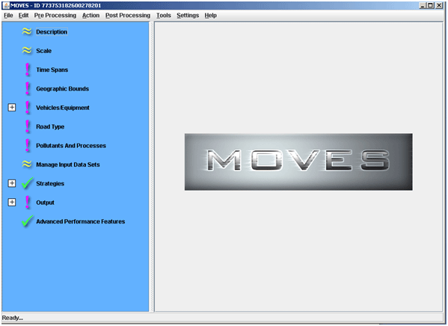
AFLEET Vehicle Air Pollutant Emissions
Generate MOVES emission factors for gasoline & diesel vehicles
  NO_{x}, PM₁₀, PM_{2.5}, VOCs, CO
  LDV = passenger car & truck; light commercial truck
  HDV = school & transit bus; refuse; single unit & combination trucks
Emissions for both old & new vehicles in current year
  Can develop footprint & examine benefit of removing old vehicles
Deterioration rates for new vehicles
  Can examine future emissions of new vehicles
Notes:
AFLEET Tool draws upon numerous data sources, but the major ones include Argonne’s GREET model…

Slide 7

AFLEET Vehicle Air Pollutant Emissions
Use relative AFV emission estimates from GREET
  Recently developed GREET HDV module examined in-use emissions
AFLEET multiplies MOVES emission factors and GREET AFV relative emission rates
  AFV compared to appropriate counterpart engine, e.g.
    Propane compared w/ gasoline
    Biodiesel compared w/ diesel
AFLEET does not include upstream or electricity generation emissions
Notes:
AFLEET Tool draws upon numerous data sources, but the major ones include Argonne’s GREET model…

Slide 8

AFLEET Tool 2017 planned Updates
Option to examine HDVs with low-NOx engines
Idling emissions and idle reduction technologies
Upstream & vehicle production emissions
Renewable diesel
Online user interface
Notes:
Proposed Optional NOx Standards
NOx Level g/bhp-hr
% Below Current Standard
0.2 (Current)
0.1 (50%)
0.05 (75%)
0.02 (90%)

Slide 9
AFLEET Summary
Argonne developed AFLEET for DOE Clean Cities to assist stakeholders & fleet operators nationwide
AFLEET can help estimate the economic and environmental costs and benefits of AFVs
  Inform new vehicle purchases
  Examine energy and emissions footprint of existing vehicles
Default data provided for key inputs
  Using your own data makes your analysis more meaningful
AFV in-use air pollutant emissions based on EPA’s MOVES and Argonne’s GREET models

Slide 10
Thank you!!!
Argonne National Laboratory’s work is supported by the U.S. Department of Energy, Office of Energy Efficiency and Renewable Energy
This work has been supported and assisted by:
Linda Bluestein: U.S. Department of Energy
Dennis Smith: U.S. Department of Energy
Marcy Rood Werpy: Argonne
Michael Wang: Argonne
Hao Cai: Argonne
Kelly Vazquez, Luis Gomes, Kevin Lee, Walter Schaefer

Slide 11
Backup Slides

Slide 12
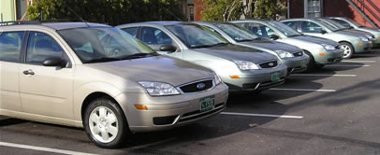
AFLEET Tutorial – Demo #1
Using the Fleet Energy & Emissions Footprint Calculator to Examine Existing Fleet
Notes:
http://energy.gov/sites/prod/files/styles/article_hero/public/Veolia_CNG2.jpg?itok=cW9_ZpO1

Slide 13
AFLEET Tutorial – Fleet Energy & Emissions Footprint Calculator
1st step: enter location on “Inputs” sheet
2nd step: if necessary, adjust fuel production assumptions on “Inputs” sheet

Slide 14
AFLEET Tutorial – Fleet Energy & Emissions Footprint Calculator
4th step: copy and paste fleet data into “Footprint” sheet
  Model year
  Annual mileage
  Fuel use
5th step: adjust vehicle type via drop-down
Note: Several fuels are not shown for clarity in this presentation

Slide 15
AFLEET Tutorial – Fleet Energy & Emissions Footprint Calculator
View existing fleet results on “Footprint Outputs” sheet

Slide 16
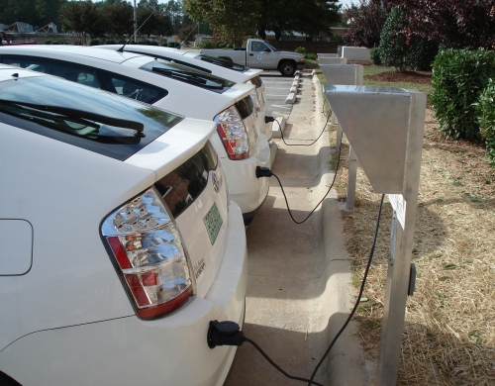
AFLEET Tutorial – Demo #2
Using Simple Payback and TCO Calculators to Compare Potential Acquisitions

Slide 17
AFLEET Tutorial – Simple Payback and TCO Calculators
1st step: enter key inputs on “Inputs” sheet
  State, County (for externalities) & vehicle type (via drop-down)
  # of vehicles, VMT, MPGGE, and purchase price
    Default and MPDGE reference values available (to the side of below tables)
  Can simulate both an LDV and HDV
Note: Red cells show values changed for demo, cell color doesn’t change in AFLEET

Slide 18
AFLEET Tutorial – Simple Payback and TCO Calculators
2nd step: enter key fuel price inputs on “Inputs” sheet
  Choose either public or private station fuel pricing (via drop-down)
    Results based on state level AFPR data
  Choose if you want to look at fuel price sensitivity for simple payback (via drop-down)
  Enter fuel price data (in respective fuel unit)

Slide 19
AFLEET Tutorial – Simple Payback and TCO Calculators
3rd step: enter TCO inputs on “Inputs” sheet

Slide 20
AFLEET Tutorial – Simple Payback and TCO Calculators
4th step: adjust fuel production assumptions on “Inputs” sheet

Slide 21
AFLEET Tutorial – Simple Payback and TCO Calculators
5th step: if examining PHEV or EREV, enter additional data on “Payback” sheet
  CD “EV mode” fuel consumption & range
  Charges per day & days driven per week
  Other secondary assumptions are on this sheet as well
Note: Several fuels are not shown for clarity in this presentation

Slide 22
AFLEET Tutorial – Simple Payback and TCO Calculators
6th step: if examining fuel price sensitivity, enter additional data on “Payback” sheet
  Enter high and low fuel prices for either public or private station
    Can either enter values or % relative to default price
    Do not have to enter multiple times for vehicles using same fuel
Note: Several fuels are not shown for clarity in this presentation

Slide 23
AFLEET Tutorial – Simple Payback and TCO Calculators
7th step: if examining infrastructure costs, enter additional data on “Payback” sheet
  Enter station type (via drop down), number of stations, and station & O&M costs
Note: Several fuels are not shown for clarity in this presentation

Slide 24
AFLEET Tutorial – Simple Payback and TCO Calculators
View results on “Payback Outputs” sheet
Note: Several fuels are not shown for clarity in this presentation

Slide 25
AFLEET Tutorial – Simple Payback and TCO Calculators
View results on “TCO Outputs” sheet
Note: Several fuels are not shown for clarity in this presentation

